Slide 1

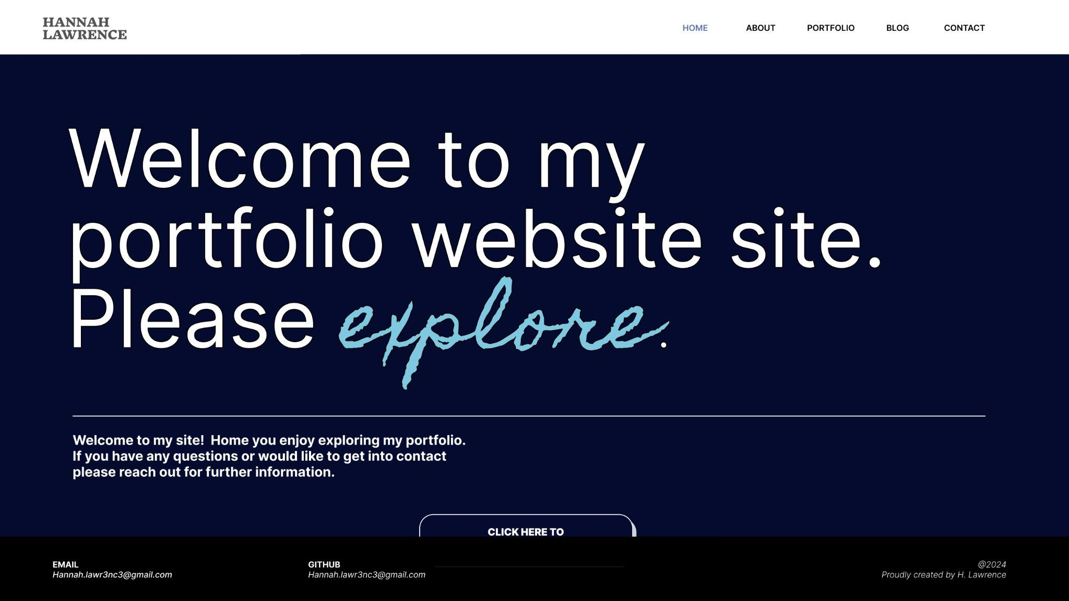

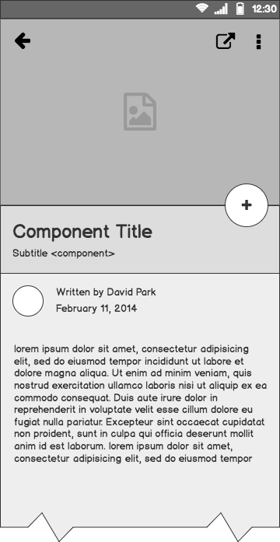
PORTFOLIO WEBSITE
Hannah Lawrence
PGM1001 - Web Development
ITP1001 - The IT Professional

Slide 2
Outline
Project Outline
Design Process
Structure
Wireframes
Deployed Site
Conclusion

Slide 3
Brief
Create a portfolio website
Website which presents you as a dev and IT professional. The purpose is to provide an online portfolio that provides information about you, your skills, interests, professional knowledge and a showcase of your work.
The target audience for the portfolio website is an employer looking to engage a dev and/or IT professional. Expect the employer to have the following knowledge and expectations: technical knowledge relating to information technology, software development/coding, programming languages and development stacks high expectations of professionalism and a positive work ethic.

Slide 4
Goal
Clean, legible design
The goal of the site was to create a clean, legible design that future employers can easily navigate. Elements such as the site's navigation, color scheme, and composition were carefully crafted to achieve this. High contrast is used throughout the site. The code is kept as clean as possible, considering the level of a beginner. This site will be regularly updated to serve as a platform to showcase future works created within the Coder Academy course. This site was designed the the purpose of providing opportunities for employment. This site will be shown to the target audience of HR departments and other industry professionals when applying for jobs as a developer.
This site was designed the the purpose of providing opportunities for employment. This site will be shown to the target audience of HR departments and other industry professionals when applying for jobs as a developer.

Slide 5
Key
information
Professional background
Illustrate abilities in relation to CSS and HTML
Provide contact details
Showcase previous projects
Provide space for future works within blog pages

Slide 6
Design Process

Slide 7

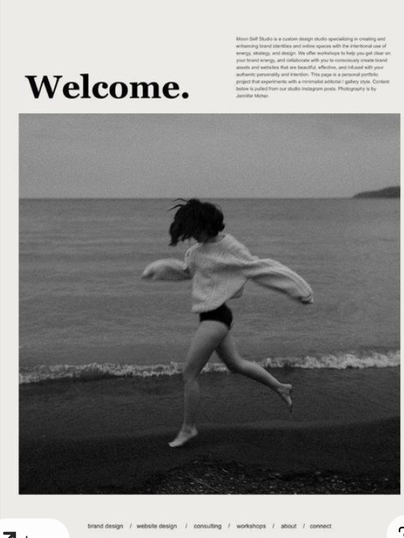
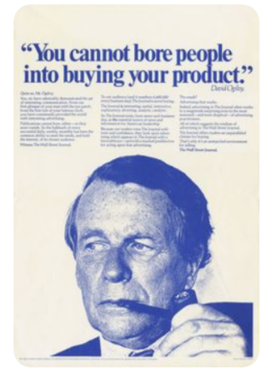
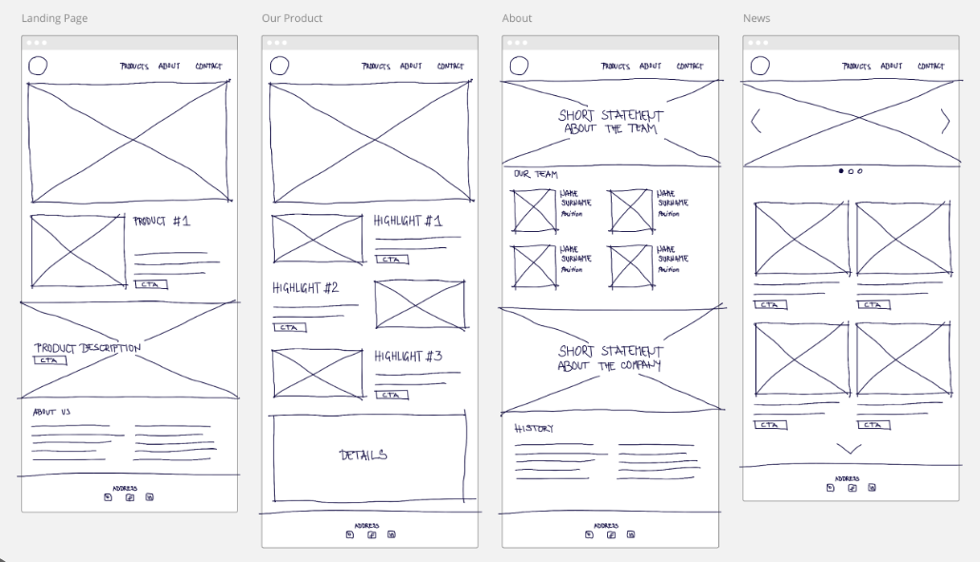
Design Process: Site Structure
Example:
Low fidelity Site
Outline of the site is basic making it easy to conceptualise and visualise the different elements.
The site was designed to be low fidelity.

Slide 8
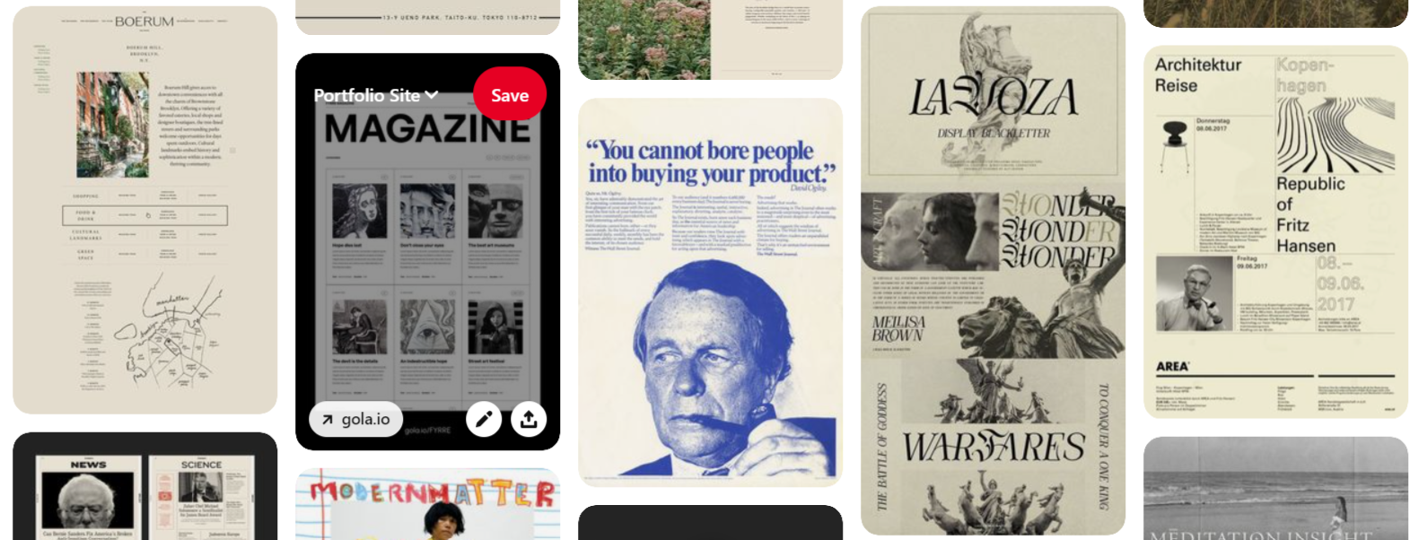
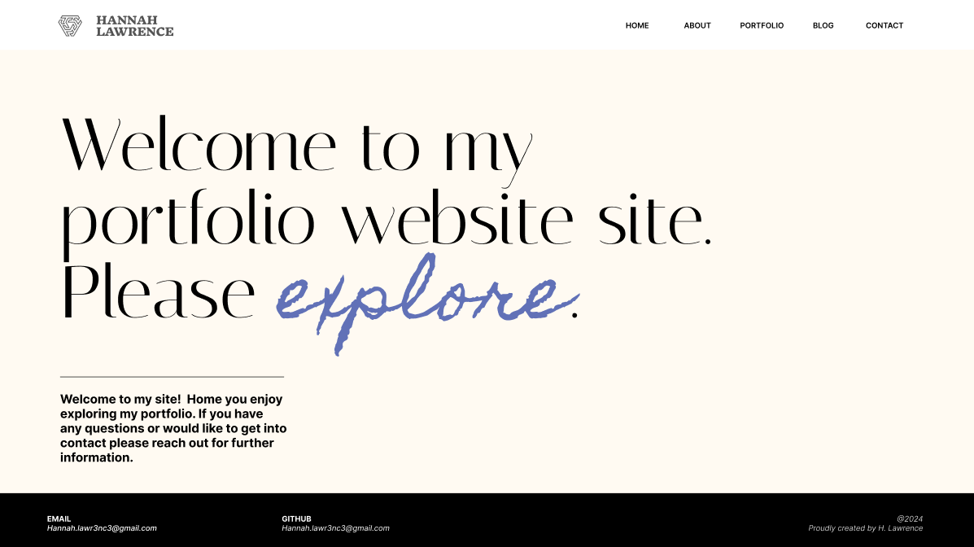
Inspiration
Design Process : Inspiration
Pinterest
Used to inspire the sites colour palette and sites original design. Look for clean and clear designs.

Slide 9
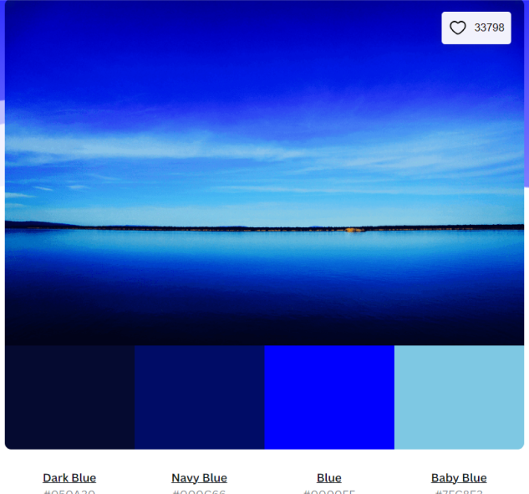
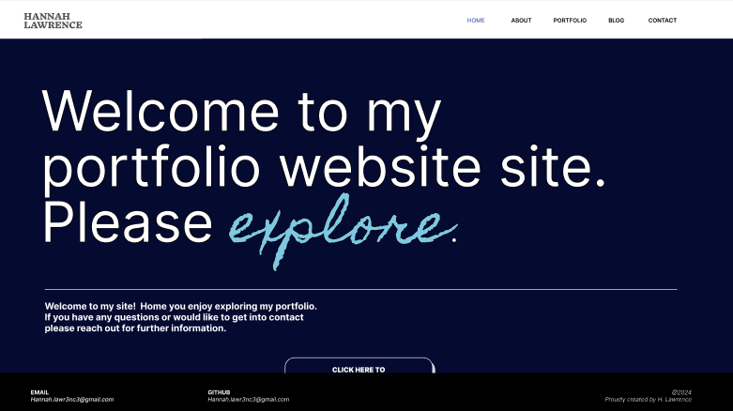
Design Process : Colour
Canva
To generate HEX codes for additional blue colours.

Slide 10
Design Process : Colour
HEX codes:
--black-100: #000000;
--blue-100: #6171B7;
--blue-200: #1D76DE;
--blue-300: #7EC8E3;
--blue-400: #0000FF;
--blue-500: #050A30;
--white-100: #FFFFFF;
--white-200: #FFFAF2;
--grey-100: #979797;
Colours
The final colours selected were based on the HEX codes from Canva and the Pinterest designs

Slide 11
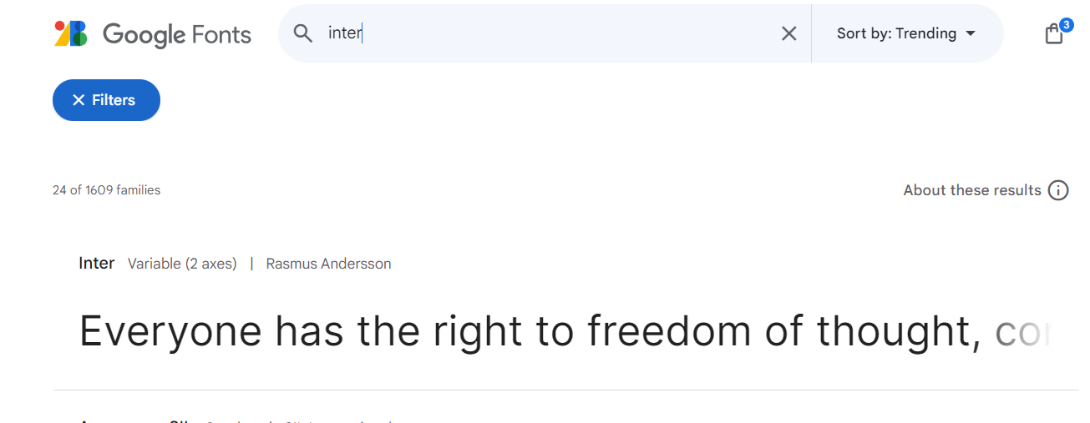
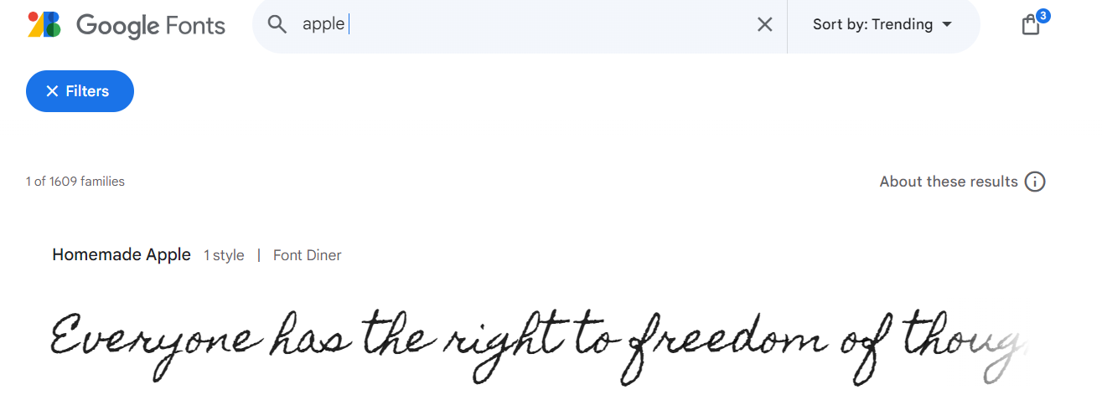
Design Process : Fonts
HomemadeApple-Regular.ttf
Italiana-Regular.ttf
Fonts
.tff files downloaded from Google Fonts.
Selected to create a clean professional feel.

Slide 12
Structure

Slide 13
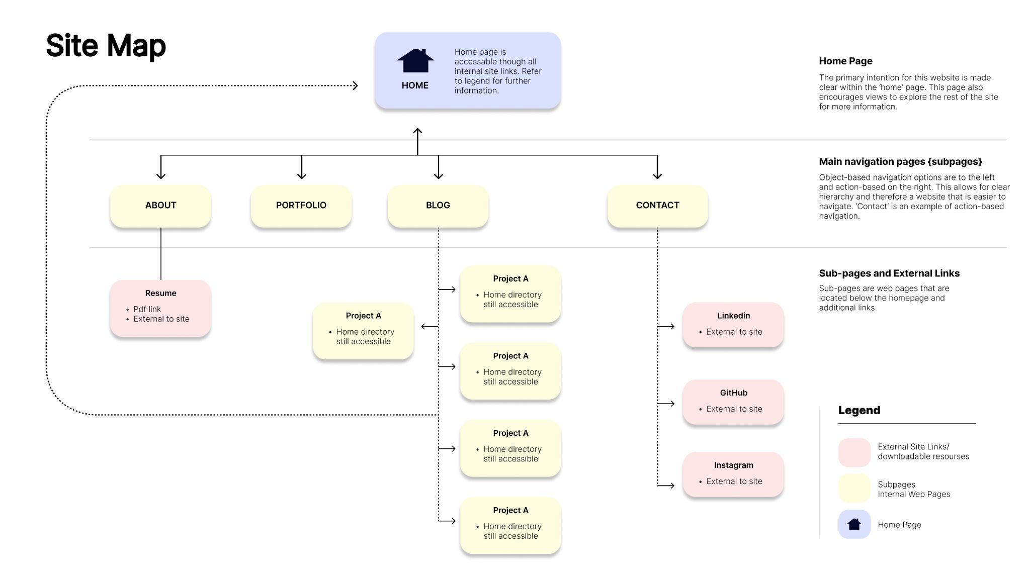
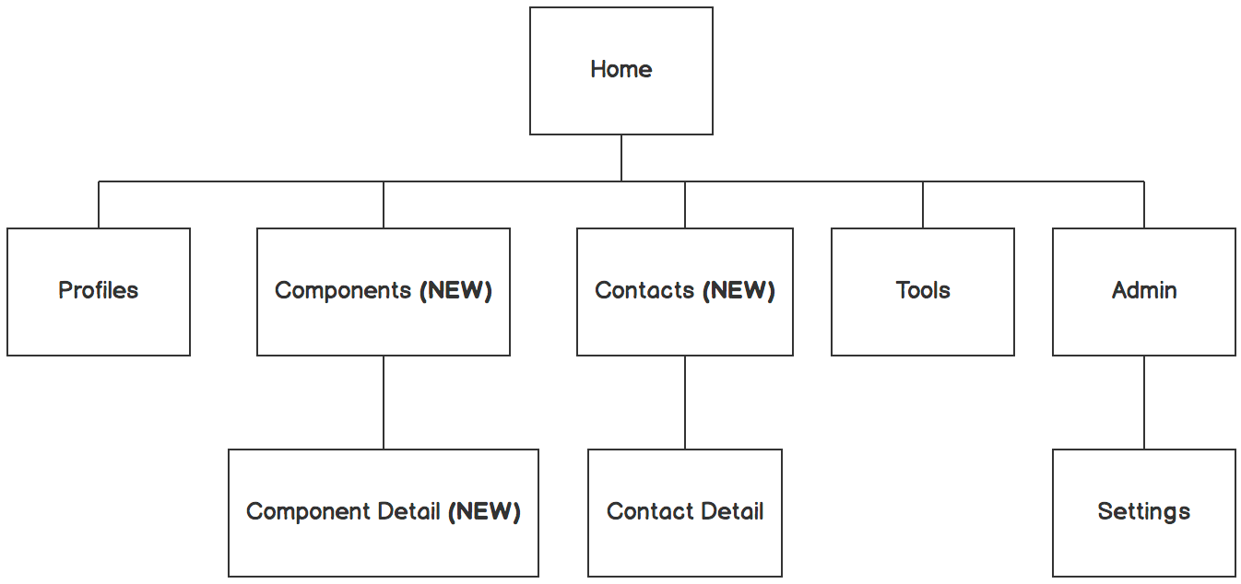
Structure: Site Map

Slide 14
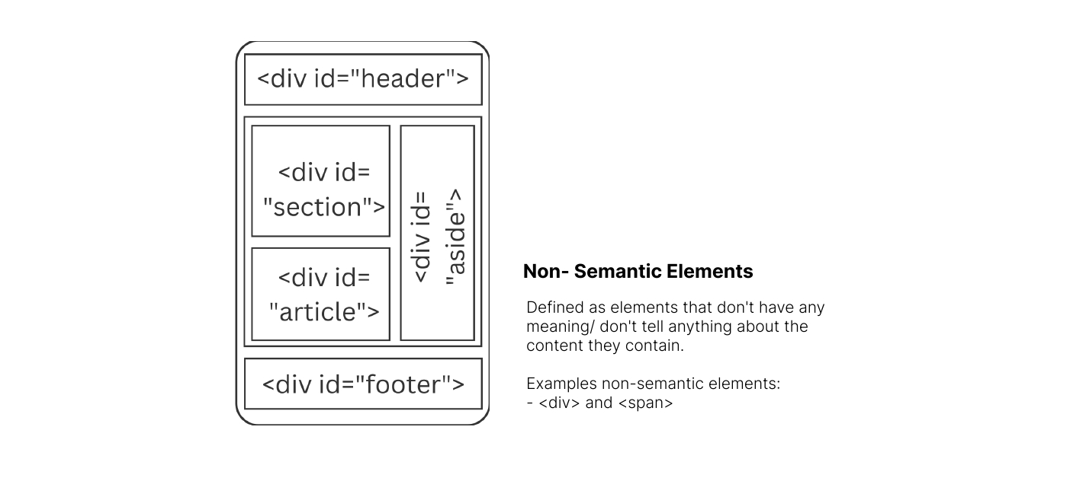
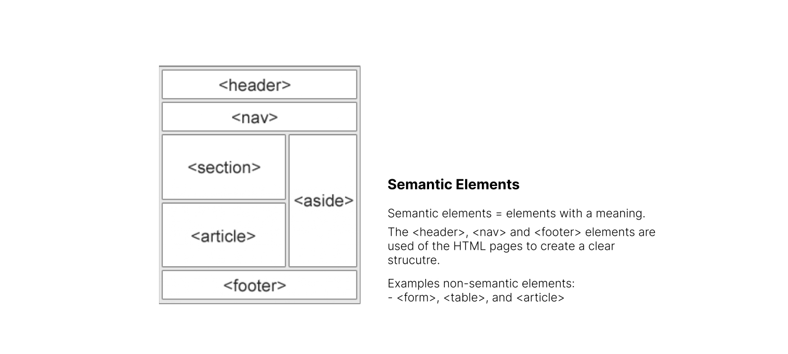
Structure: Elements

Slide 15
Wireframes

Slide 16

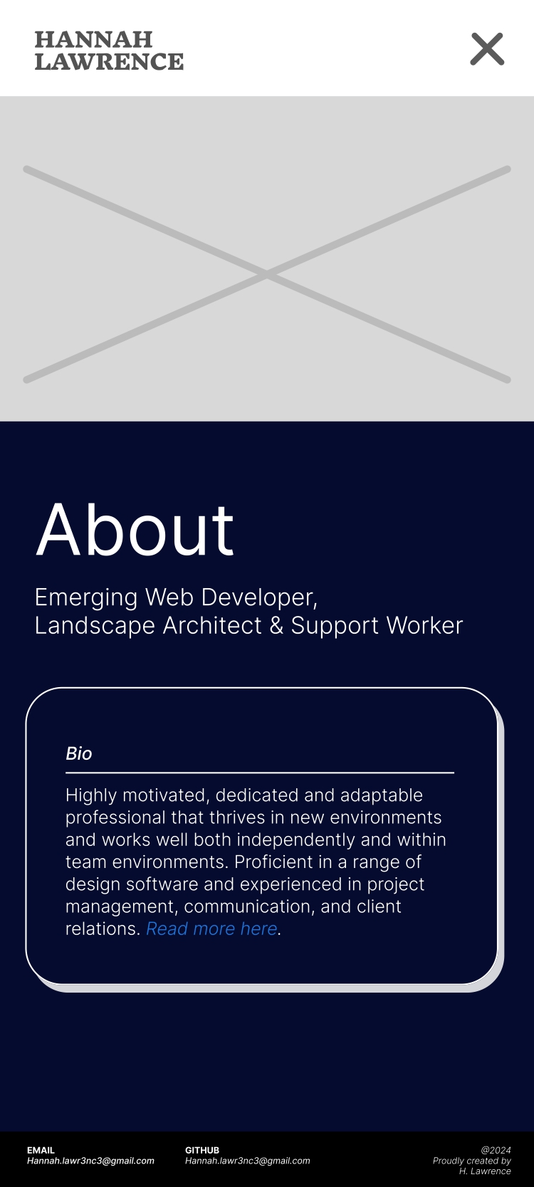
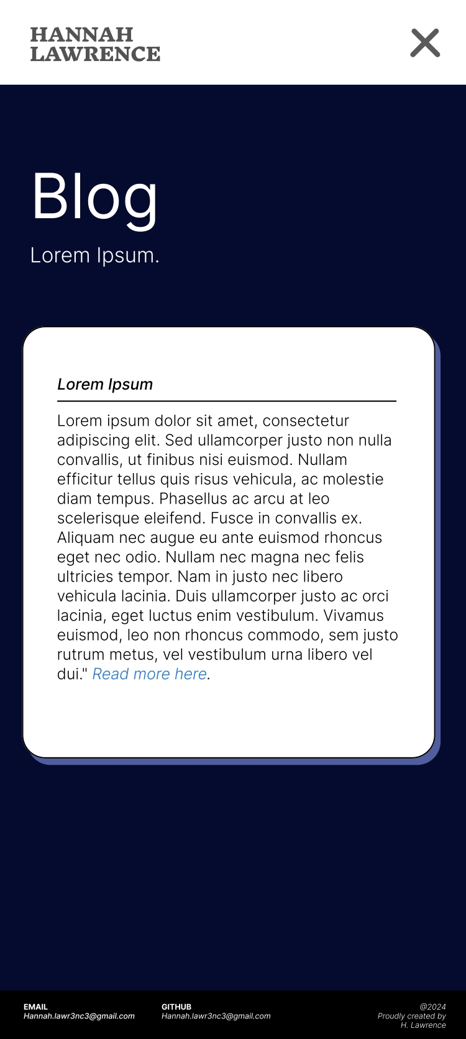
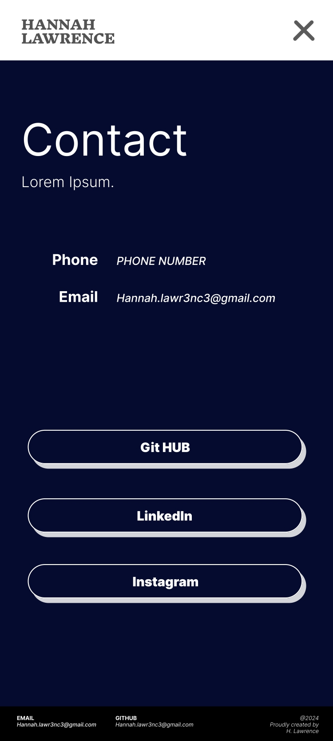
Wireframes: Mobile
Refer to markdown file for further details.

Slide 17
Wireframes: Desktop
Refer to markdown file for further details.

Slide 18
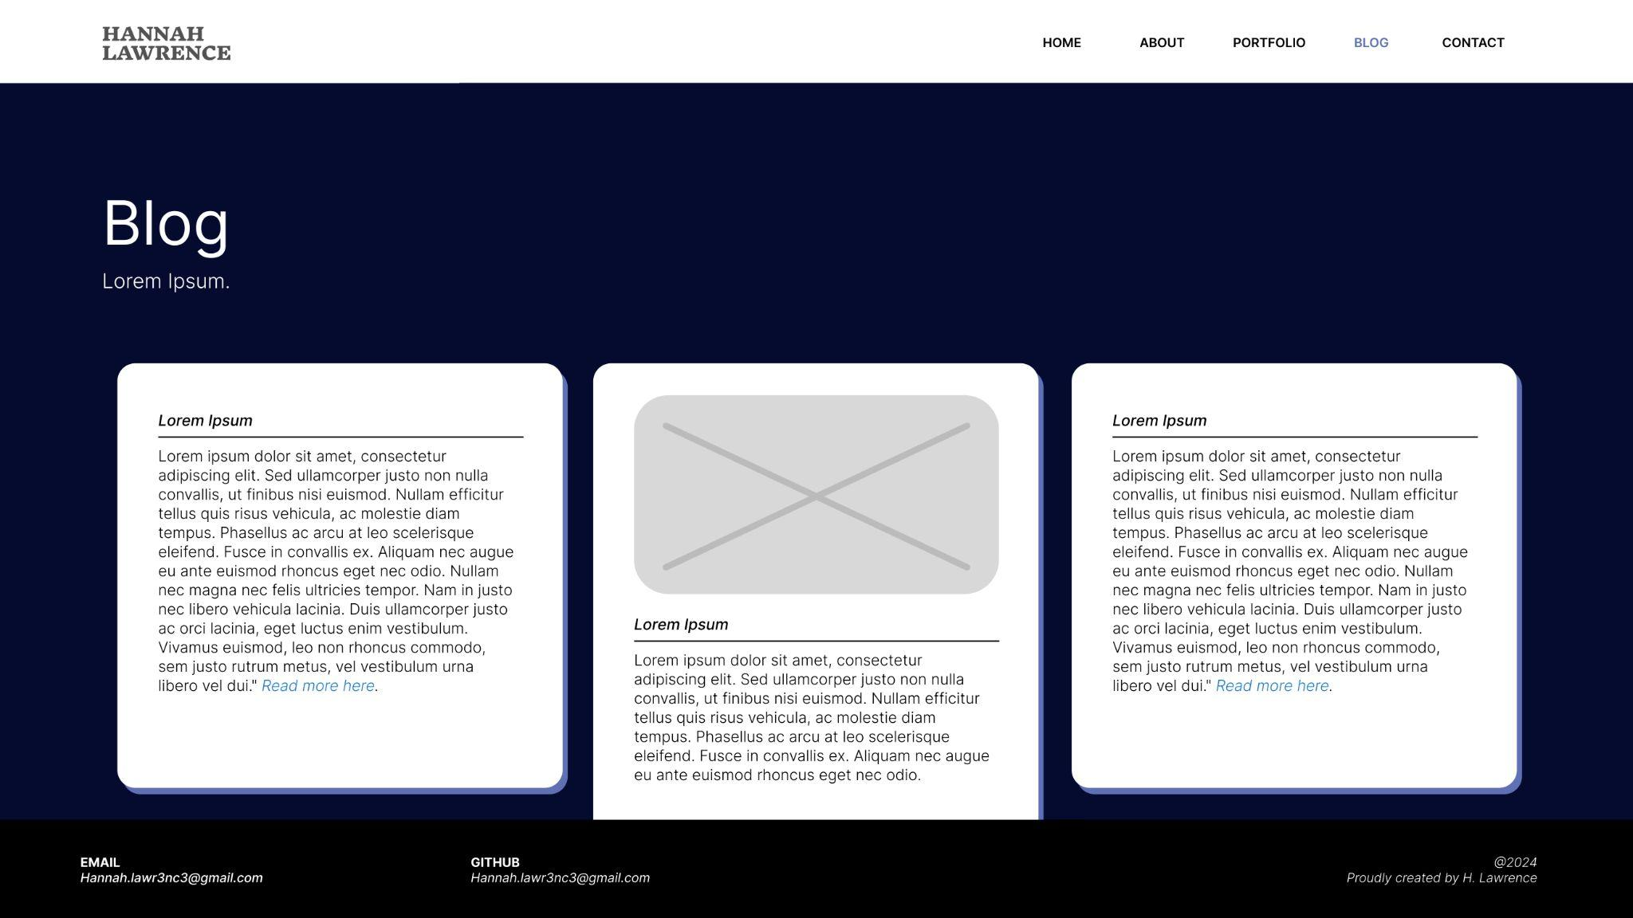
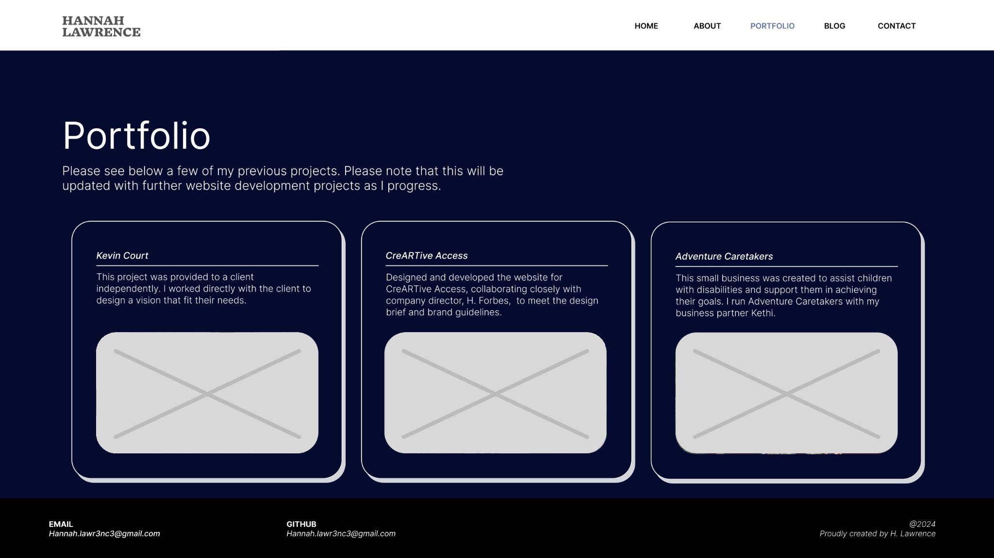
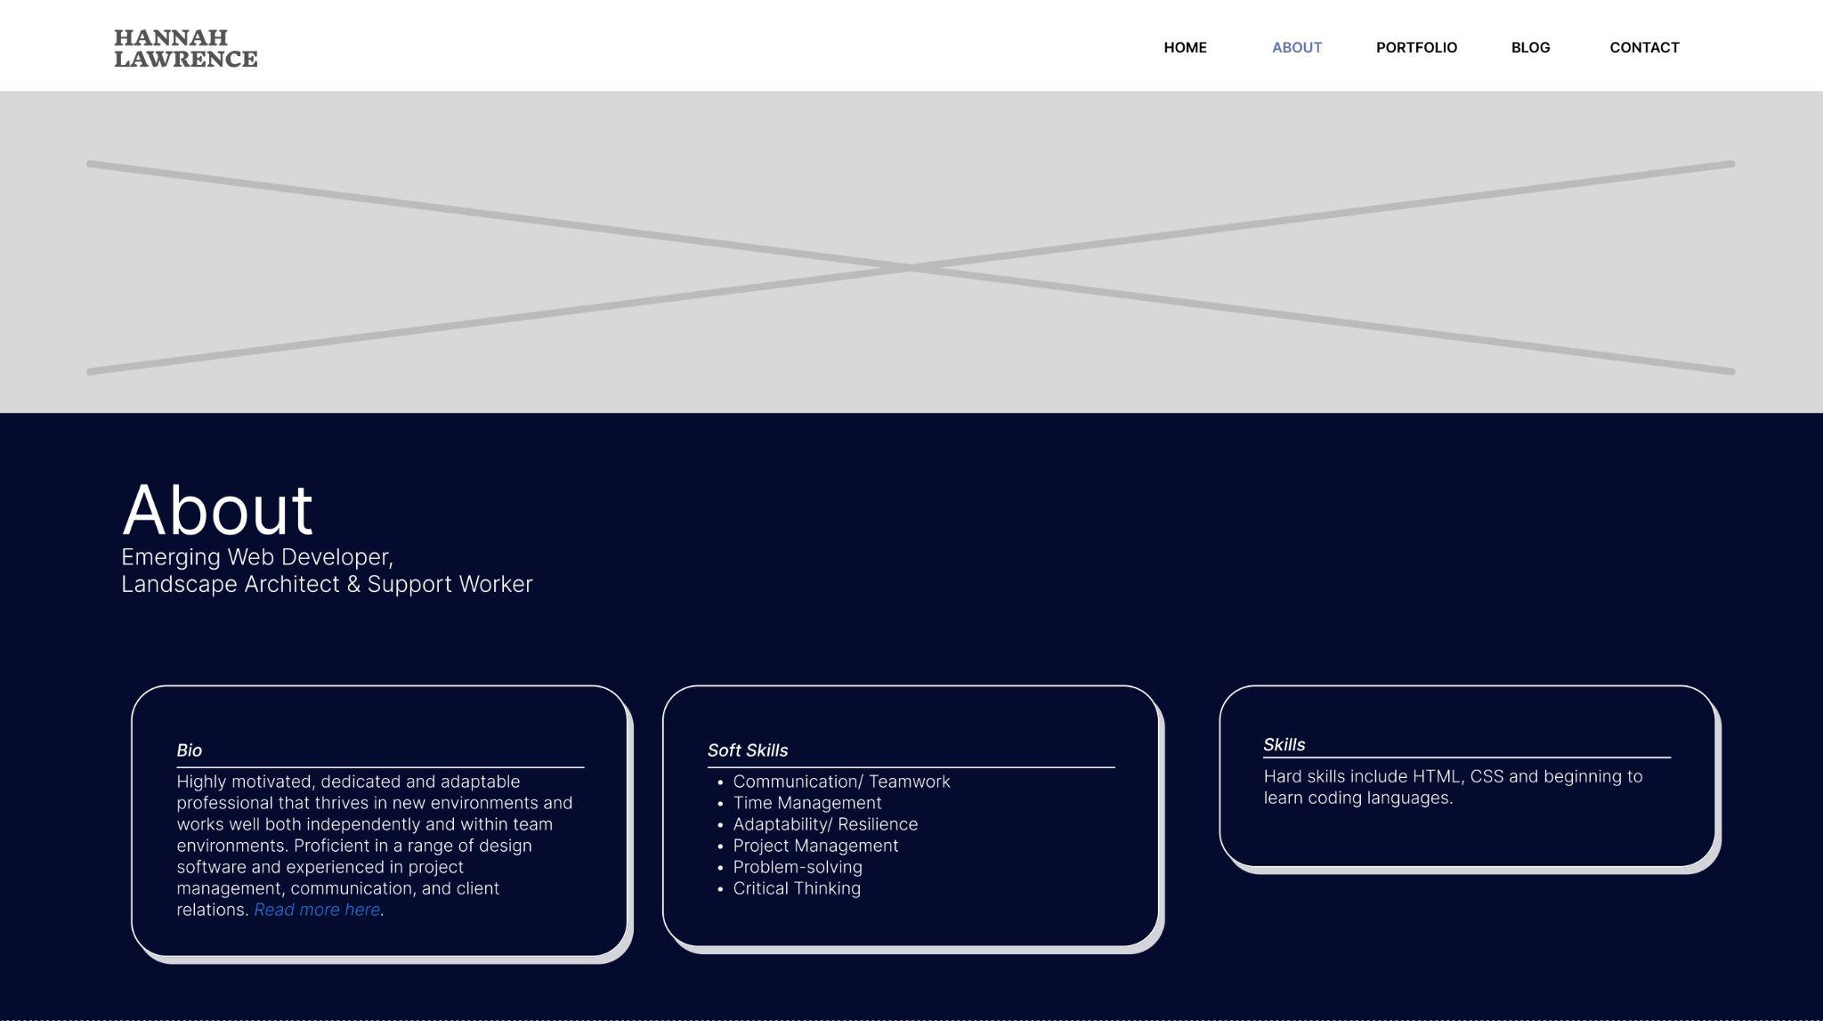
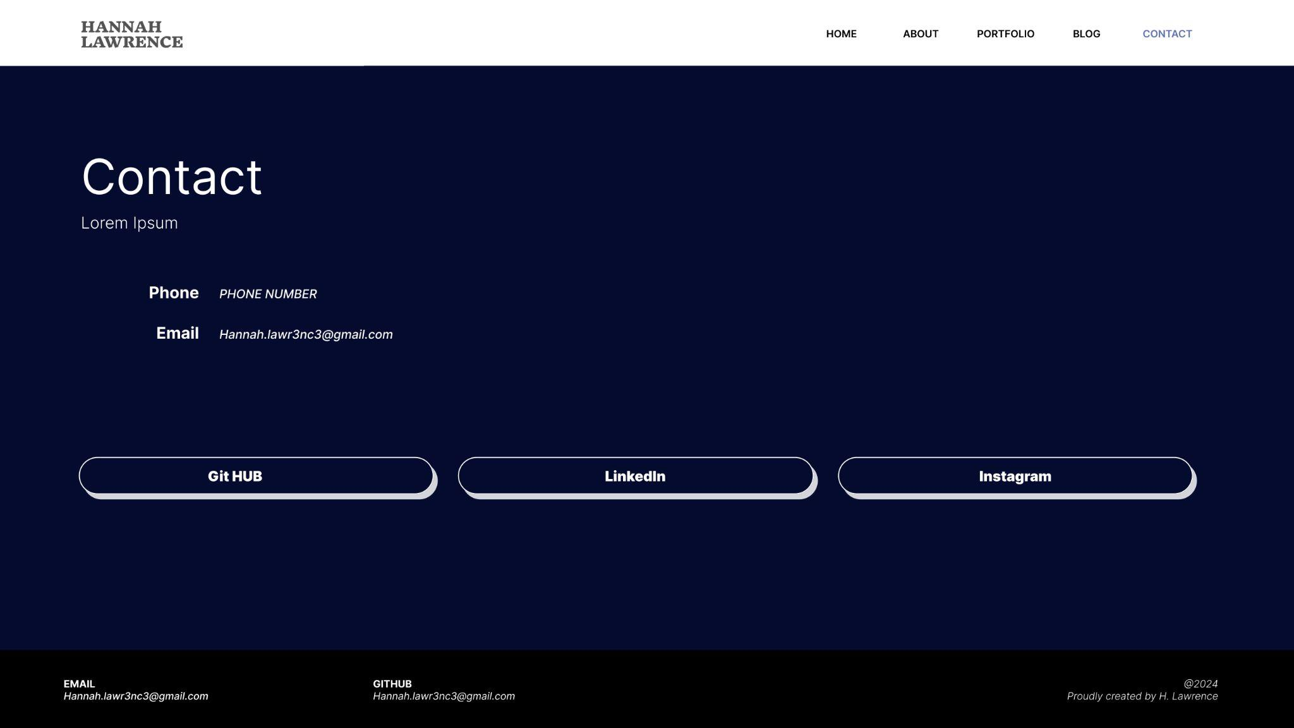
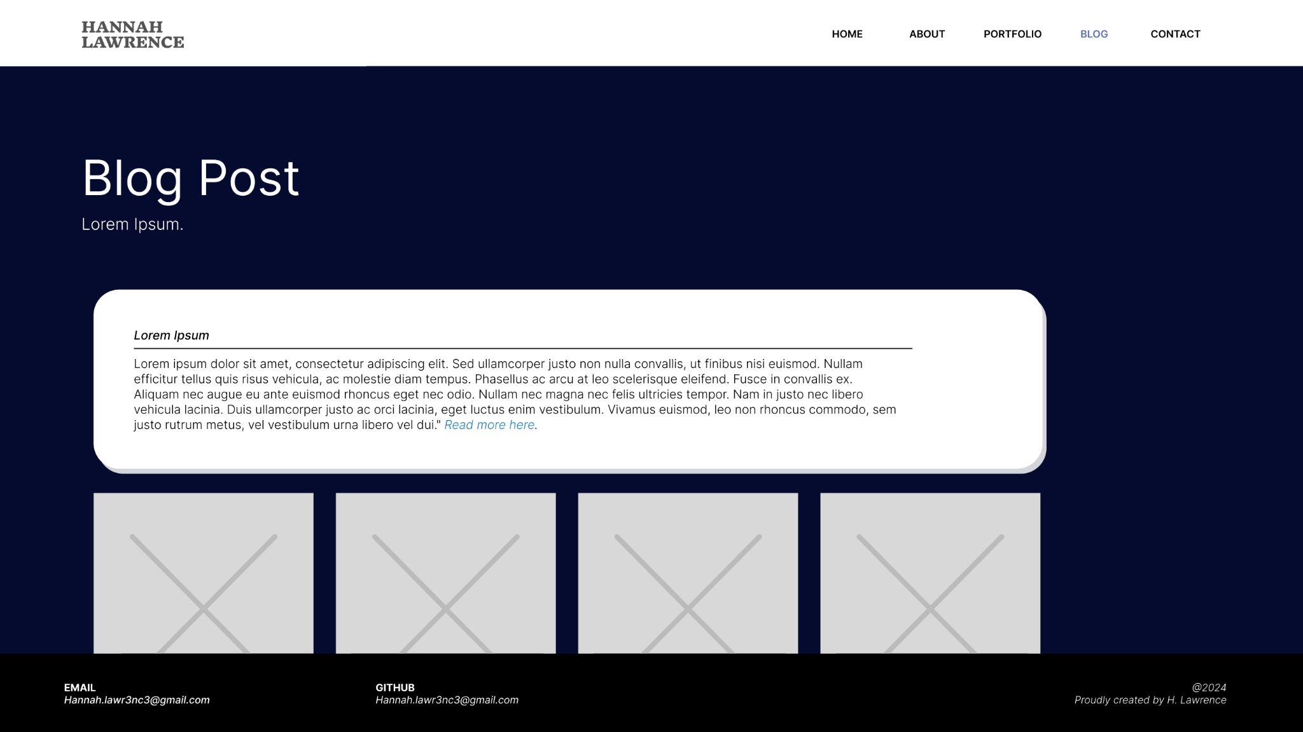
Wireframes: Desktop
Refer to markdown file for further details.

Slide 19
Deployed Site

Slide 20
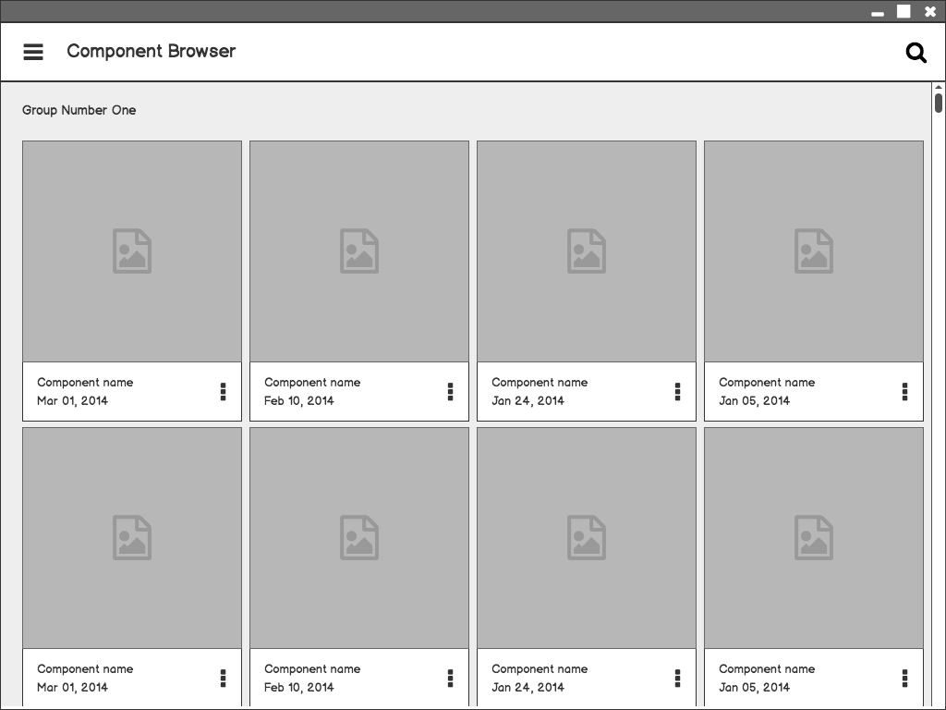

Component Browser
Call out key parts of the UI
Balsamiq Tip | Use the Balsamiq add-on to make your own wireframe.

Slide 21
Component Detail (Mobile)
Articulate your design decisions by adding justifications

Slide 22
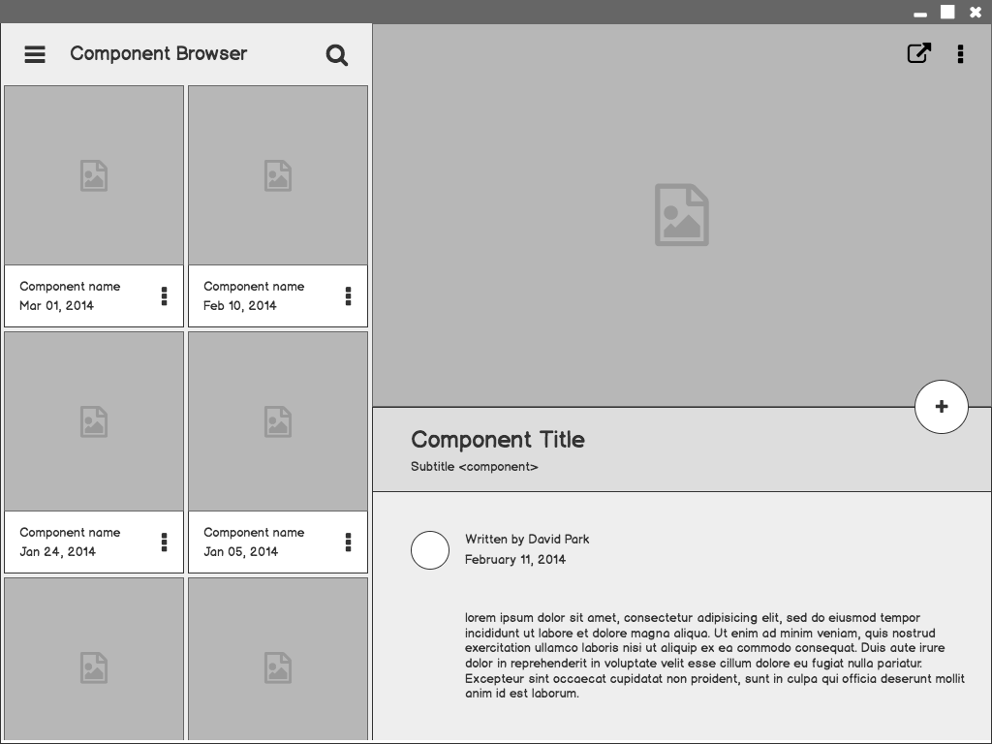
Component Detail

Slide 23
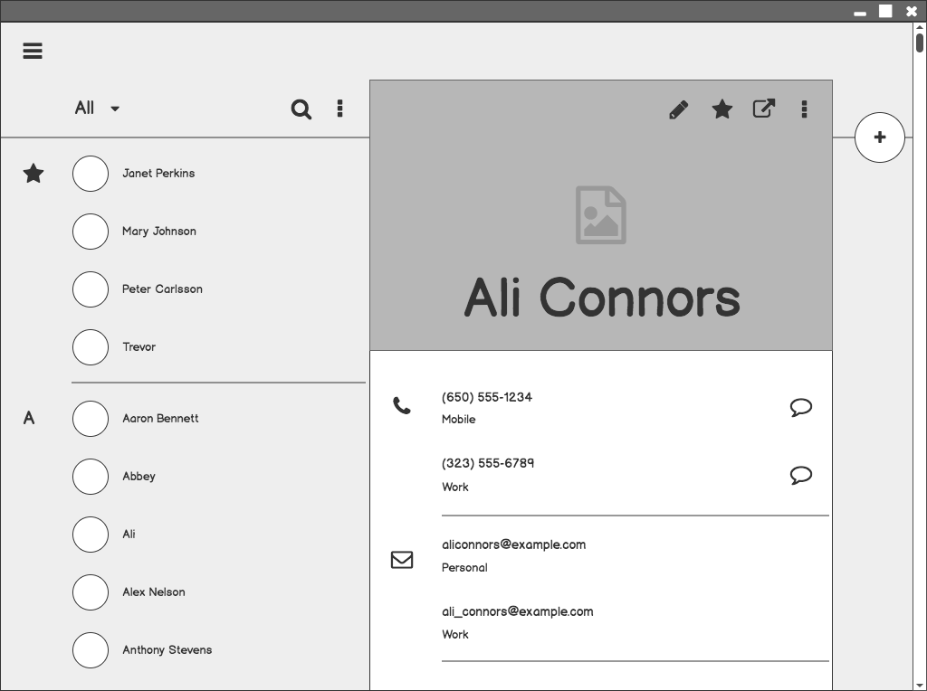
Contacts

Slide 24
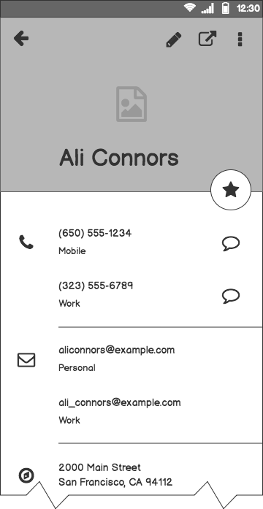
Contacts (Mobile)

Slide 25

Styling Elements: Animations
Animations
Logo was created for the site for additional interest. This was also made a link to allow the viewer to go back to the home screen. Bounce animation was used for the logo. The animation occurs when the users mouse hovers over the logo.

Slide 26
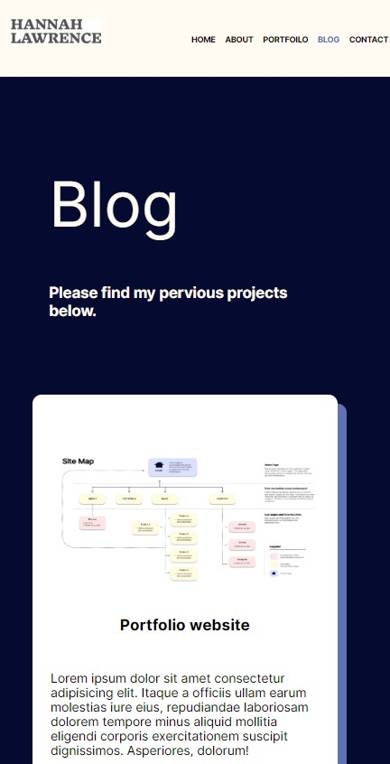
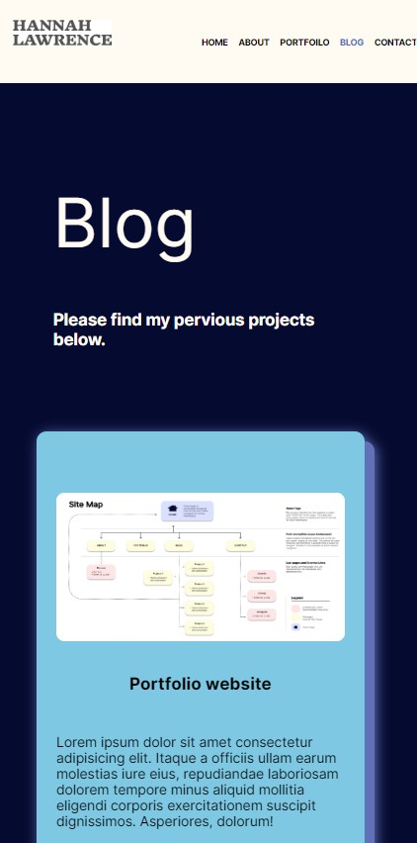

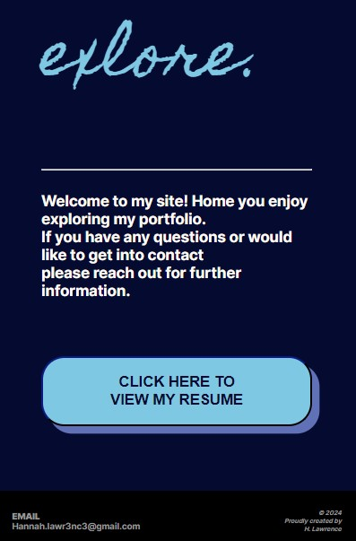
Styling Elements: Hover States
:Hover {
The changes of states were created for additional visual interest. These allow for the site to appear professional and ensures that the viewer stays engaged.

Slide 27
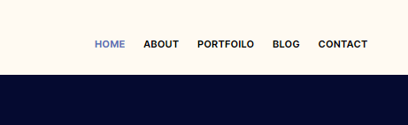
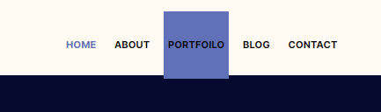
Styling Elements: Hover States
Colour change to show the site that the user is currently on .
Hover & styling
The changes of states were created for additional visual interest. These allow for the site to appear professional and ensures that the viewer stays engaged.

Slide 28
Conclusion

Slide 29
Challenges
Time Management
Spent too much time doing wireframes that I ran out of time for coding.
Deployment
Deployment of site not working to to labeling files incorrectly. I used a number system to organise the files whilst coding. This did not allow me to link files correctly during deployment.
Skill gap
Learning to code while making the site made the process much longer than it needed to be. Basic errors also occurred.

Slide 30
Site review
Accessibility
Score from accessibility checker.

Slide 31
Next Steps
Incorporate additional projects within the ‘portfolio’ and ‘blog’ sections.
Add additional styling as new languages are taught within the course. This includes Java and Python.

Slide 32
Thank you!

